Slide 1

CDC’s 6|18 Initiative:
Overview Slides
Updated: December 16, 2019
Developed by the Center for Health Care Strategies through support from the Robert Wood Johnson Foundation.
The views expressed here do not necessarily reflect the views of the Foundation.

Slide 2
What is CDC’s 6|18 Initiative?
Promoting the adoption of evidence-based interventions in
collaboration with health care purchasers, payers, and providers
|
6
18
High-burden
health conditions
Evidence-based
interventions that improve health and control costs
CDC.gov/sixeighteen

Slide 3

CDC’s 6|18 Initiative Goals
Improve health and control costs using
specific evidence-based interventions
Establish sustainable cross-sector partnerships between public health and health care purchasers, health plans, and providers to address shared health priorities

Slide 4

6 High-Burden Health Conditions
The 6|18 Initiative focuses on six common and costly health conditions — tobacco use, high blood pressure, inappropriate antibiotic use, asthma, unintended pregnancies, and type 2 diabetes — and associated interventions with evidence of improved health outcomes and cost reduction or neutrality.
CDC used the following criteria to choose conditions/interventions:
Health conditions that affect large numbers of people and are associated with high costs
Interventions that are specific and underutilized
Interventions that prevent or control the condition and yield short-term savings
Interventions that can be implemented in both clinical and community settings
1
2
3
4

Slide 5


Why Adopt the CDC’s 6|18 Initiative?
Aligns with quality improvement goals
Accelerates the impact of value-based payment reform efforts
Promotes effective and results-driven cross-sector collaboration
“6|18 fostered communication and collaboration so that we each know what each other is doing.”
“No longer do we think reimbursement is only a Medicaid issue.”
- State Medicaid
- State Public Health

Slide 6


Control Asthma
THE ISSUE
  More than 24 million Americans have asthma, affecting
  one-in-12 children and one-in-14 adults.
  In 2009, asthma costing private insurance, Medicaid, Medicare, and other sources an estimated $62.8 billion.
EVIDENCE-BASED INTERVENTIONS
  Use the 2007 National Asthma Education and Prevention Program as clinical practice guidelines.
  Promote strategies that improve access and adherence to asthma medications and devices.
  Expand access to intensive self-management education by licensed professionals or qualified lay health workers for patients whose asthma is not well-controlled with medical management.
  Expand access to home visits by licensed professionals or qualified lay health workers to provide intensive self-management education and reduce home asthma triggers for patients whose asthma is not well-controlled with medical and self-management education.
618resources.chcs.org

Slide 7


Reduce Tobacco Use
THE ISSUE
  Smoking is the leading cause of preventable disease and mortality in the U.S., accounting for 480,000 premature deaths each year.
  Tobacco use results in more than $300 billion in health care costs and lost productivity annually.
EVIDENCE-BASED INTERVENTIONS
  Increase access to tobacco cessation treatments, including individual, group, and telephone counseling, and FDA-approved cessation medications (in accordance with 2008 Public Health Service Clinical Practice Guidelines and the 2015 U.S. Preventive Services Task Force recommendations).
  Remove barriers that impede access to covered cessation treatments, such as cost-sharing and prior authorization.
  Promote increased use of covered treatment benefits by tobacco users.
618resources.chcs.org

Slide 8


Prevent Type 2 Diabetes
THE ISSUE
  About 84 million Americans age 18 years or older have prediabetes, and 30.3 million individuals have diabetes.
  Total direct and indirect costs for diabetes in the U.S. in 2017 were estimated at $327 billion.
EVIDENCE-BASED INTERVENTIONS
  Expand access to the National Diabetes Prevention Program, a lifestyle change program for preventing type 2 diabetes.
618resources.chcs.org

Slide 9


Prevent Unintended Pregnancy
THE ISSUE
  Approximately 50 percent of pregnancies in the U.S. are unintended.
  Unintended pregnancies increase poor maternal and infant outcomes — resulting in $21 billion in direct medical costs in 2010.
EVIDENCE-BASED INTERVENTIONS
  Reimburse providers for the full range of contraceptive services for women of childbearing age.
  Reimburse providers for the actual cost of FDA-approved contraceptive methods.
  Unbundle payment for long-acting reversible contraceptives from other postpartum services.
  Remove administrative barriers to receipt of contraceptive services.
618resources.chcs.org

Slide 10


Improve Antibiotic Use
THE ISSUE
  Each year in the U.S., at least two million illnesses and 23,000 deaths can be attributed to antibiotic-resistant infections.
  While antibiotic-resistant infections can happen anywhere, most antibiotic resistance related deaths happen in health care settings.
EVIDENCE-BASED INTERVENTION
  Require antibiotic stewardship programs in all hospitals and skilled nursing facilities, in alignment with CDC’s Core Elements of Hospital Antibiotic Stewardship Programs and The Core Elements of Antibiotic Stewardship for Nursing Homes.
  Improve outpatient antibiotic prescribing by incentivizing providers to follow CDC’s Core Elements of Outpatient Antibiotic Stewardship.
618resources.chcs.org

Slide 11


Control High Blood Pressure
THE ISSUE
  Each year in the U.S., heart disease, stroke, and other vascular diseases contribute to 800,000 deaths.
  High blood pressure costs the nation $46 billion each year.
EVIDENCE-BASED INTERVENTIONS
  Implement strategies that improve adherence to anti-hypertensive and lipid-lowering prescription medications via expanded access to (1) low cost medication copayments, fixed dose medication combinations, extended medication fills; (2) innovative pharmacy packaging; and (3) improved care coordination using standardized protocols, primary care team, medication therapy management programs and self-monitoring of blood pressure with clinical support.
  Provide home blood pressure monitors to patients with high blood pressure and reimburse for the clinical support services required for self-measured blood pressure monitoring.
618resources.chcs.org

Slide 12



3 Key Phases of Implementing
CDC’s 6|18 Initiative Interventions
Medicaid Coverage
  Utilize state plan amendments, legislation/regulatory changes, and contract modifications to remove barriers and increase access to care
Provider Adoption
  Promote covered benefits to providers to increase provision of or referral to services, with guidance on billing procedures
Consumer Utilization
  Deliver targeted promotion of covered benefits to beneficiaries to ensure that they are aware of available benefits and services

Slide 13
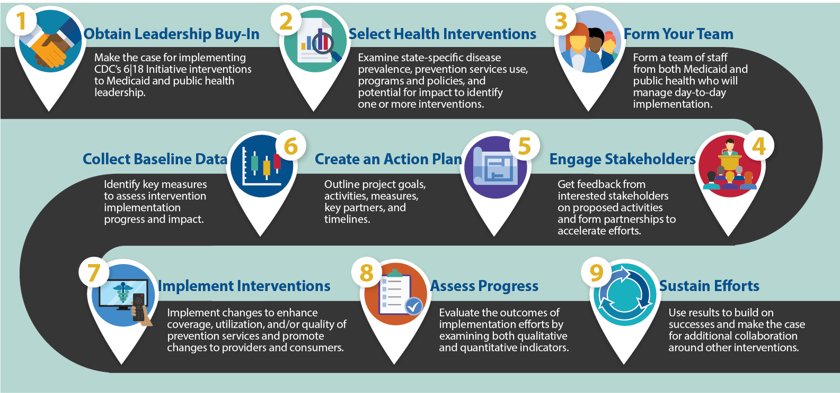
Roadmap for Implementing
CDC’s 6|18 Interventions

Slide 14
CDC’s 6|18 Initiative Participants
ME
WA
MT
ND
RI*
OR
MN
NY
WI
CT*
ID
SD
MI*
PA
WY*
VT
NH
NE*
IA
OH
NJ
MA
NV*
IL
IN
WV
VA
CA
UT
CO*
KY*
DE
MD
KS*
MO*
NC*
TN
DC
OK
SC
LA County
AZ
NM
AR
KEY
AL
GA
MS
Year IV teams
TX*
LA
Graduate teams
FL
AK
USVI
HI
CNMI*
AS
GU
PR

Slide 15

Examples of 6|18 State Accomplishments
Baseline coverage and utilization
assessment (e.g. MCO Surveys)
State Plan Amendments to enhance Medicaid benefits
Changes in billing
MCO contractual negotiations
Payment pilots
New scope of practice legislative authority
Provider and member education and outreach

Slide 16


6|18 In Action: Maryland,
Preventing Type 2 Diabetes
Goals
  Increase payer coverage of the National Diabetes Prevention Program (DPP) and promote implementation alignment across health systems
  Enhance provider referrals to the DPP
Activities and Accomplishments
  Applying for an 1115 waiver amendment to continue and build on current demonstration to cover the DPP through Medicaid MCOs; over 600 beneficiaries were enrolled as of January 2018, with preliminary data suggesting significant weight loss
  Boosting DPP referrals by expanding promising electronic referral pilots and developing a DPP education campaign for primary care providers
  Aligning diabetes prevention goals with state payment reform efforts through development of a diabetes prevalence quality measure

Slide 17
6|18 In Action: Michigan,
Controlling Asthma
Goal
  Improve access and adherence to asthma medications and devices, and expand utilization of intensive self-management education
Activities and Accomplishments
  Engaged with Medicaid leadership to add spacers and associated equipment to Medicaid’s common formulary
  Secured commitment from Medicaid MCOs to provide four spacers per year without prior authorization
  Promoted “Managing Asthma Through Case-Managing in Homes” (MATCH) program to Medicaid MCOs; program participation at three MATCH sites led to an 81% reduction in the percentage of individuals with 3+ ED visits and a 70% reduction in the percentage of individuals with at least one hospitalization¹

Slide 18

Accomplishments:
Minnesota Reducing Tobacco Use
Goals
  Assess and address variation in Medicaid MCO tobacco cessation benefits and services
  Increase provider, enrollee and community-based organizations’ awareness and use of free Medicaid tobacco cessation benefits and services
Activities and Accomplishments
  Surveyed Medicaid MCOs to identify variation in benefits and used results to engage with MCOs not following state cessation policies – resulting in improved and more uniform cessation treatment coverage.
  Increased awareness of free Medicaid benefits by engaging community groups and populations most disparately impacted by the health harms of tobacco.
  Analyzed the All Payer Claims Database to establish a baseline for utilization of cessation medications across payers

Slide 19

Accomplishments: New York
Preventing Unintended Pregnancy
Goal
  Increase access to and utilization of effective or highly effective contraceptive methods — most notably, long-acting reversible contraceptives (LARCs), which include intrauterine devices and implants.
Activities and Accomplishments
  Amended State Medicaid Plan to carve LARC payment out of federally qualified health center (FQHC) prospective payment system for Medicaid fee-for-service and managed care organizations (MCOs).
  Identified provider champions to inform provider education and outreach.
  Promoted provider education resources through a partnership with the American College of Obstetricians and Gynecologists District II.

Slide 20
Sample Results Associated with Adopting CDC’s 6|18 Initiative Interventions
$66M
Estimated avoided state and federal costs from 2010 to 2014 through Colorado’s efforts to improve access to the most effective contraceptive methods¹
Reduction in asthma-related hospital and emergency department costs through Rhode Island’s Home Asthma Response Program for high-risk children²
Estimated medical savings for cardiovascular conditions for every
$1 invested in Massachusetts’ enhanced Medicaid tobacco cessation benefit³
75%
$3.10
$

Slide 21
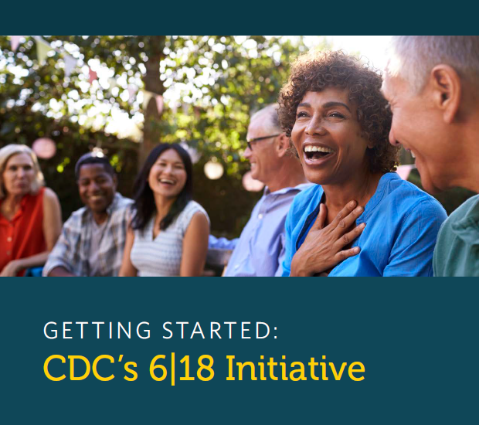
6|18 Getting Started Guide
ASTHO developed a guide to help state Medicaid and public health agencies build and strengthen partnerships to improve coverage and uptake of preventive services.
Provides information on key considerations and steps for states.
Notes:
As part of our resource development work, ASTHO developed a Guide on Getting Started with the CDC’s 6|18 Initiative.
The guide includes information on key considerations for state teams on planning and implementing the 6|18 initiative, including initial steps to consider when thinking about forming a 6|18 team.
The guide also includes information on complementary roles and expertise of state Medicaid and public health agencies in a detailed chart.
As part of our resource development work, ASTHO developed a Guide on Getting Started with the CDC’s 6|18 Initiative.
The guide includes information on key considerations for state teams on planning and implementing the 6|18 initiative, including initial steps to consider when thinking about forming a 6|18 team.
The guide also includes information on complementary roles and expertise of state Medicaid and public health agencies in a detailed chart.

Slide 22
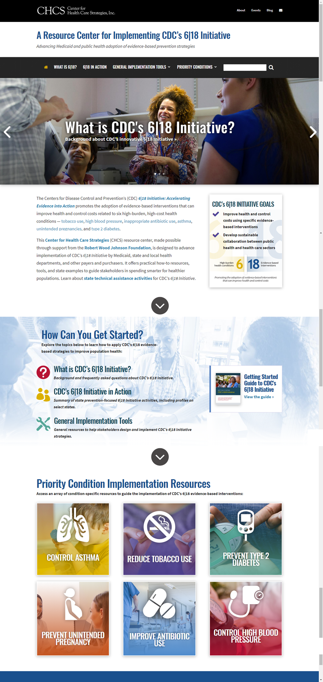


Visit CHCS’ Resource Center for Implementing CDC’s 6|18 Initiative
Online resource center, made possible by the
Robert Wood Johnson Foundation, to help Medicaid agencies and MCOs collaborate with public health departments to launch 6|18 interventions
Offers practical how-to resources, including:
  6|18 in Action - Interactive map of 6|18 activities from across the country and profiles of select state activities
  General resources to help stakeholders get started with 6|18 interventions
  Health condition-specific resources to guide the implementation of CDC’s 6|18 Initiative strategies
  www.618resources.chcs.org

